Slide 1
Linux Filesystem Hierarchy

Slide 2
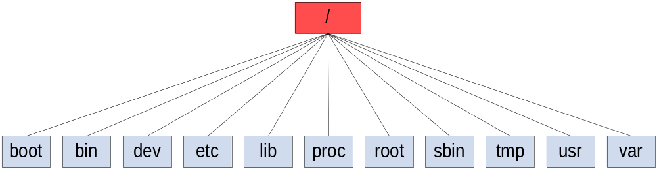
The Root Directory “/”

Slide 3
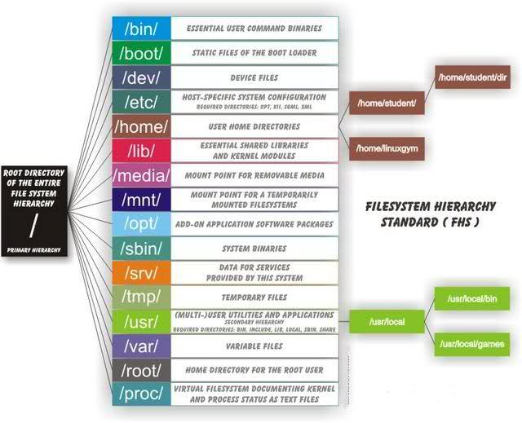

Slide 4
The Root Directory
/bin
/boot
/dev
/etc
/home
/initrd
/lib
/lost+found
/media
/mnt
/opt
/proc
/root
/sbin
/usr
/srv
/tmp
/var

Slide 5
1. /bin
All the executable binary programs (file) required during booting, repairing, files required to run into single-user-mode, and other important, basic commands viz., cat, df, tar, rpm, wc, history, etc.

Slide 6
1. /bin …(cont)
cat
chgrp
chmod
chown
cp
date
dd
df
dmesg
echo
false
hostname
kill
ln
login
ls
mkdir
mknod
more
mount
mv
ps
pwd
rm
rmdir
sed
sh
stty
su
sync
true
umount
uname

Slide 7
2. /boot
Holds important files during boot-up process, including Linux Kernel.
Contains everything required for the boot process except for configuration files not needed at boot time
Stores data that is used before the kernel begins executing user-mode programs

Slide 8
2. /boot … detail
/boot/boot.0300
/boot/boot.b
/boot/config-kernel-version
/boot/map
/boot/vmlinuz
/boot/vmlinuz-kernel-version
…
Backup master boot record.
The basic boot sector
Installed kernel configuration. A config line such as: CONFIG_FONT_8x8=y
The location of the kernel
Normally the kernel or symbolic link to the kernel

Slide 9
3. /dev
Contains device files for all the hardware devices on the machine e.g., cdrom, cpu, etc. Usualy is the location of device files
'block devices' are devices that store or hold data
'character devices' can be thought of as devices that transmit or transfer data

Slide 10
4. /etc
Contains all system related, application’s configuration files
Local file used to control the operation of a program

Slide 11
4. /etc … detail
/etc/hosts : This file is used to define a system name and domain combination with a specific IP address
  127.0.0.1 localhost ::1 localhost
  ip6-localhost ip6-loopback
  fe00::0 ip6-localnet
  ff00::0 ip6-mcastprefix
  ff02::1 ip6-allnodes
  ff02::2 ip6-allrouters
  ff02::3 ip6-allhosts
  192.168.0.99 debian.localdomain.com debian
  192.168.0.1 ws001

Slide 12
5. /home
The user home directories
Every time a new user is created, a directory in the name of user is created within home directory.
Accessible only to its owner and the system administrator.Contains the user’s personal configuration files.

Slide 13
6. /initrd
Initrd is mainly designed to allow system startup to occur in two phases, where the kernel comes up with a minimum set of compiled-in drivers, and where additional modules are loaded from initrd.
Provides the capability to load a RAM disk by the boot loader. This RAM disk can then be mounted as the root file system and programs can be run from it. Afterwards, a new root file system can be mounted from a different device. The previous root (from initrd) is then moved to a directory and can be subsequently unmounted.

Slide 14
7. /lib
Contains kernel modules and those shared library images (the C programming code library) needed to boot the system and run the commands in the root filesystem, ie. by binaries in /bin and /sbin

Slide 15
8. /lost+found
Contains the files which were recovered after an unexpected event, such as a improper shutdown.
Try to move each file back to its original location

Slide 16
9. /media
Contains subdirectories which are used as mount points for removeable media such as floppy disks, cdroms and zip disks
Temporary mount directory is created for removable devices viz., media/cdrom.

Slide 17
10. /mnt
Temporary mount directory for mounting file system.
This is a generic mount point under mounted (mount is to make a filesystem available to the system) the filesystems or devices.
When a filesystem no longer needs to be mounted, it can be unmounted with umount
  mount /dev/hda2 /home
  umount /dev/hda2

Slide 18
11. /opt
Optional is abbreviated as opt. Contains third party application software.
This directory is reserved for all the software and add-on packages that are not part of the default installation

Slide 19
12. /proc
A virtual and pseudo file-system which contains information about running process with a particularProcess-id aka pid.
Virtual filesystem, runtime system information (e.g. system memory, devices mounted, hardware configuration, etc).
To view, use “cat”. Use “vi” to edit.

Slide 20
13. /root
The home directory of the System Administrator, 'root'
This is the home directory of root user and should never be confused with ‘/‘
Why not in '/home'? Because '/home' is often located on a different partition or even on another system and would thus be inaccessible to 'root' when - for some reason - only '/' is mounted.

Slide 21
14. /sbin
Contains binary executable programs, required by System Administrator, for Maintenance. Viz.,iptables, fdisk, ifconfig, swapon, reboot, etc.
Like /bin bet less important
/sbin should contain only binaries essential for booting, restoring, recovering, and/or repairing the system in addition to the binaries in /bin.

Slide 22
14. /sbin … detail
shutdown
Fastboot
Fasthalt
fdisk
fsck
fsck.*
getty
halt
ifconfig
Command to bring the system down.
Reboot the system without checking the disks (optional)
Stop the system without checking the disks (optional)
Partition table manipulator (optional)
File system check and repair utility (optional)
File system check and repair utility for a specific filesystem (optional)
The getty program (optional)
Command to stop the system (optional)
Configure a network interface (optional)

Slide 23
15. /usr
Contains executable binaries, documentation, source code, libraries .
the most important directories in the system as it contains all the user binaries, their documentation, libraries, header files, etc.... User programs like telnet, ftp, etc.... as well, can be found here.

Slide 24
16. /var
Stands for variable. The contents of this file is expected to grow. This directory contains log, temp files.
Contains variable data, files and directories the system must be able to write to during operation, like system logging files, mail and printer spool directories, and transient and temporary files

